Slide 1
Developing a Chat-GPT interaction to assess Normalized Difference Vegetation Index (NDVI) in R studio.
Damilola Ajewole and Sunday Olaniyan

Slide 2
Background
Remote sensing datasets are large and complex
The Hierarchical Data Format (HDF) is a file format and I/O library designed for storing, exchanging, managing and archiving complex remote sensing data.
NetCDF is a set of software libraries and self-describing, machine-independent data formats that support the creation, access, and sharing of array-oriented scientific data.
Acquiring and analyzing can be cumbersome
Many approaches involve scripting to acquire
Background Objectives Prompts and debugging Success Discussion and conclusion

Slide 3
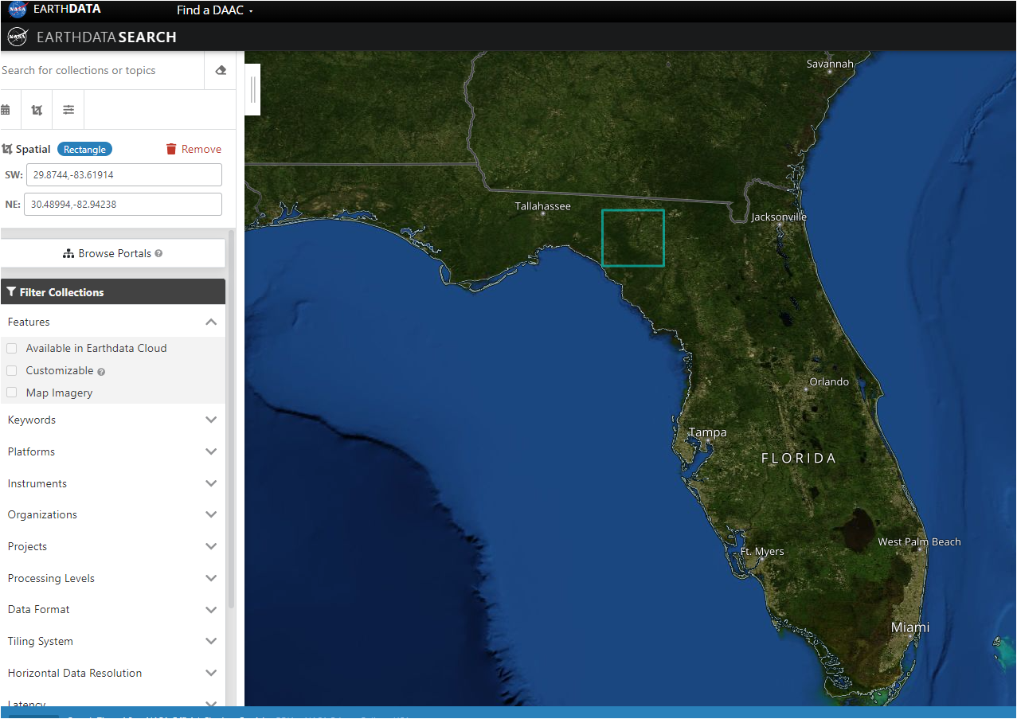
https://search.earthdata.nasa.gov/search
Background Objectives Prompts and debugging Success Discussion and conclusion

Slide 4
Objectives
With the help of Chat-GPT 3.5, Develop a simple code to download remote sensing datasets with the urls.
Attempt to download NDVI dataset from NASA’s repository
Document and understand which kinds of prompts lead ChatGPT to produce most useful and efficient codes.
Evaluate performance of both humans and Chat-GPT 3.5 in this process.

Slide 5
Prompting
Code generation
Errors and Debugging
Background Objectives Prompts and debugging Success Discussion and conclusion

Slide 6
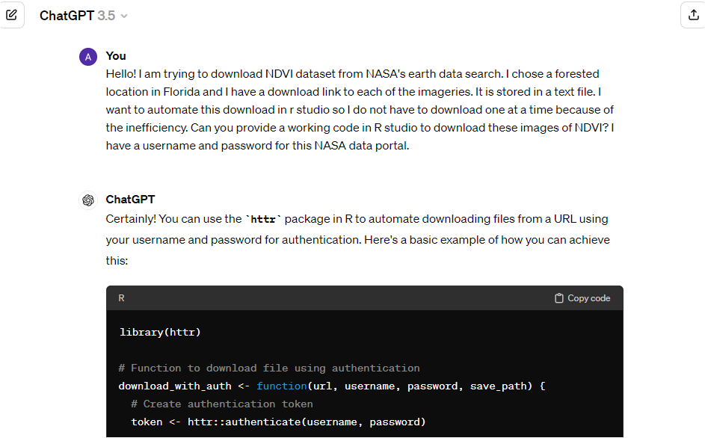
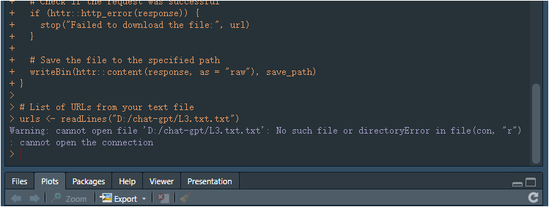
Background Objectives Prompts and debugging Success Discussion and conclusion

Slide 7
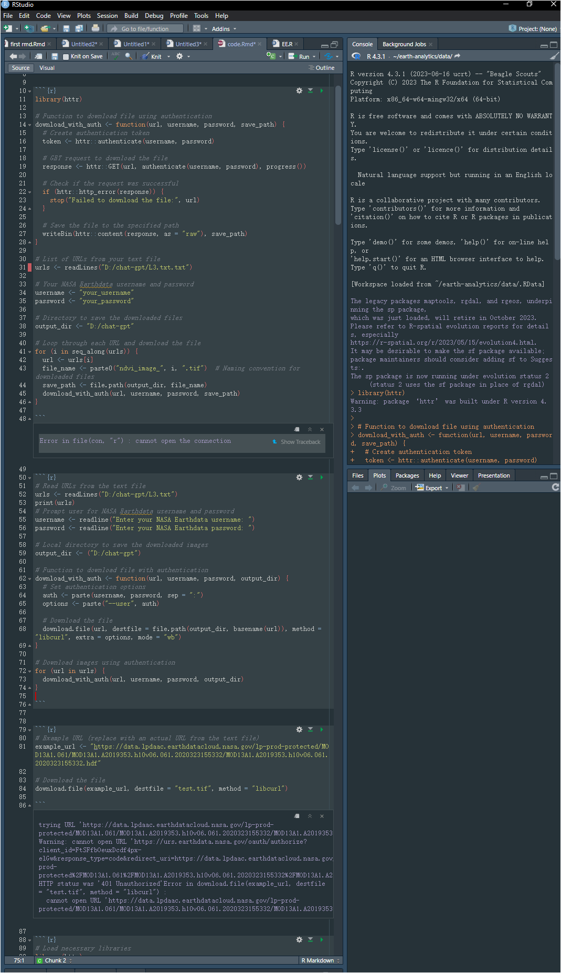
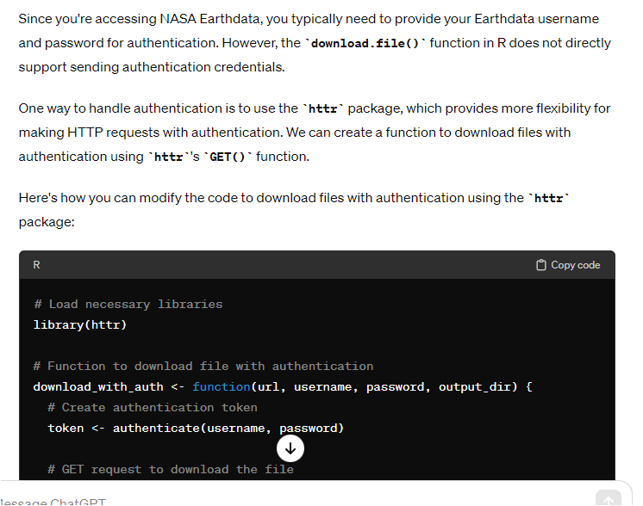
Background Objectives Prompts and debugging Success Discussion and conclusion

Slide 8
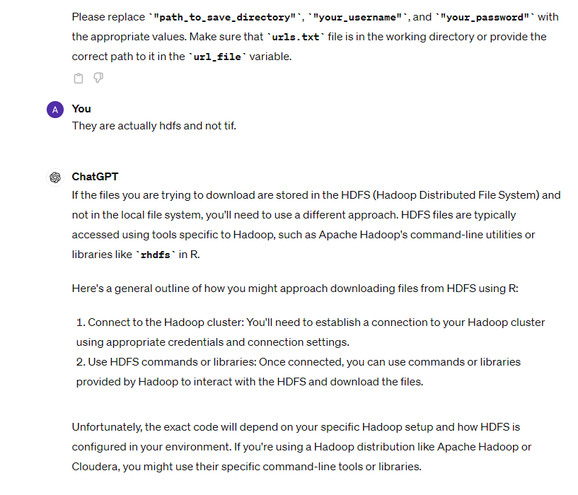
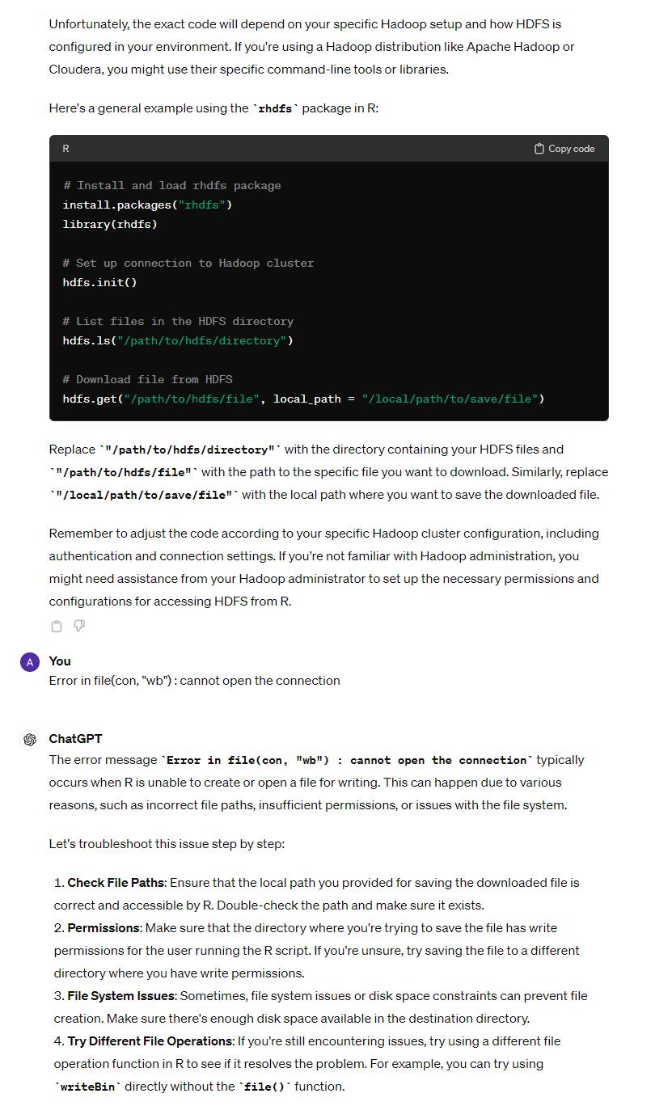
Background Objectives Prompts and debugging Success Discussion and conclusion

Slide 9
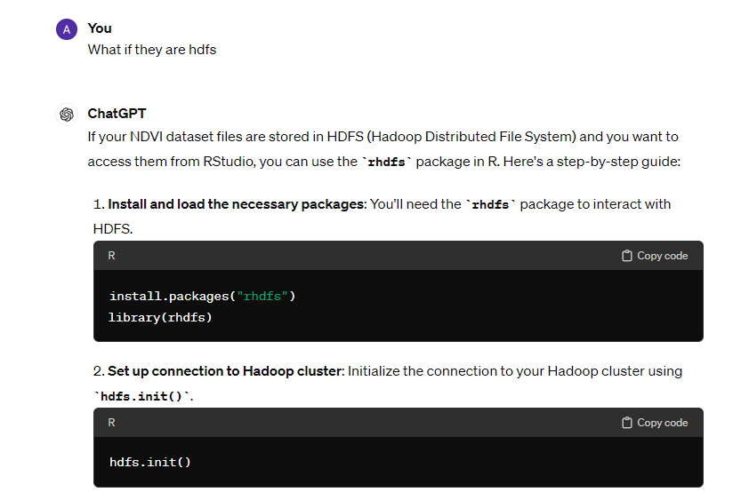
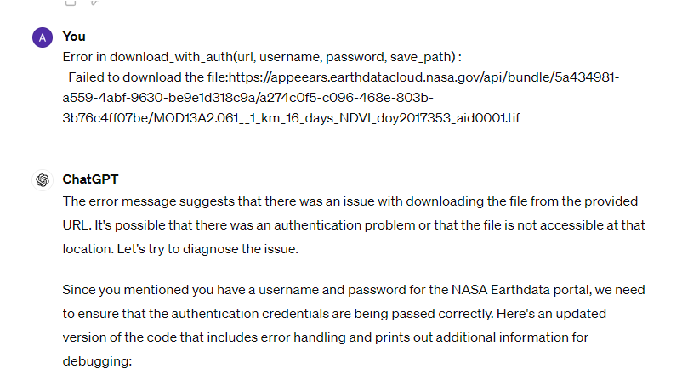
Skidding away
Background Objectives Prompts and debugging Success Discussion and conclusion

Slide 10
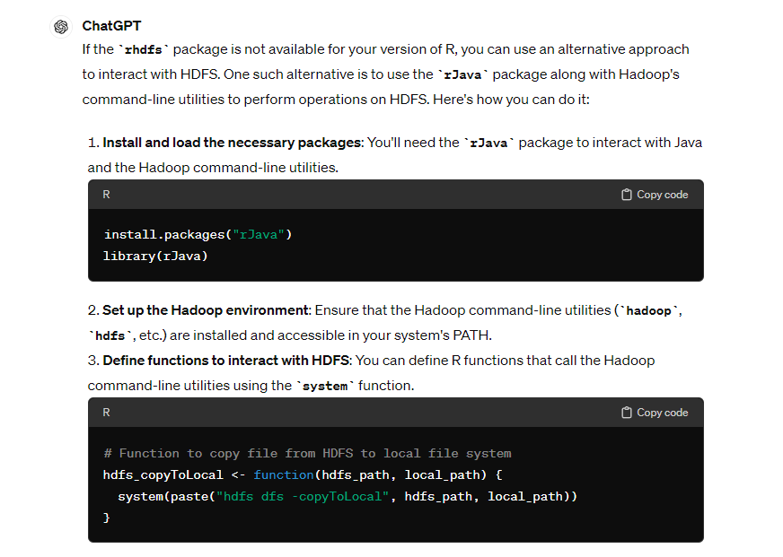
Background Objectives Prompts and debugging Success Discussion and conclusion

Slide 11
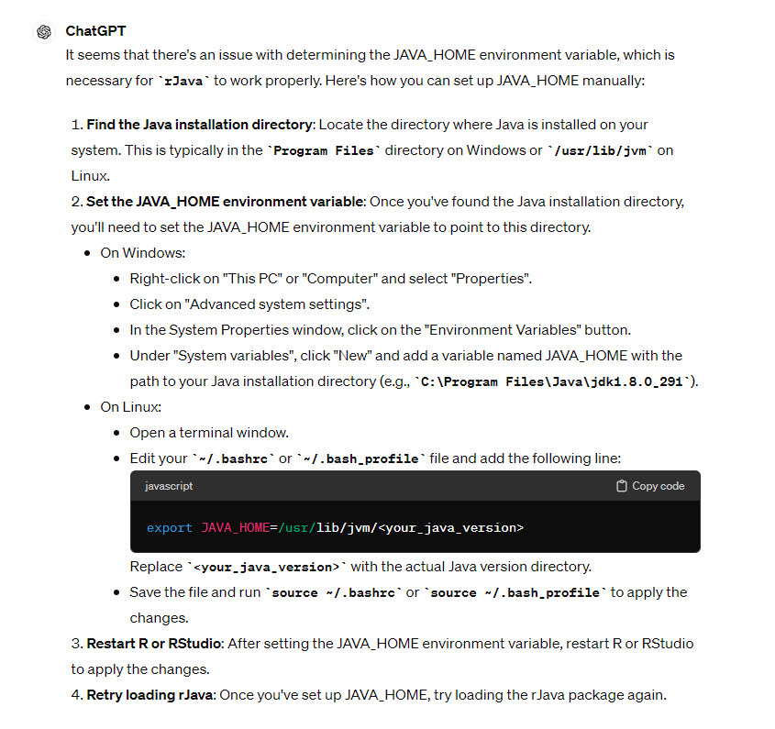
Background Objectives Prompts and debugging Success Discussion and conclusion

Slide 12
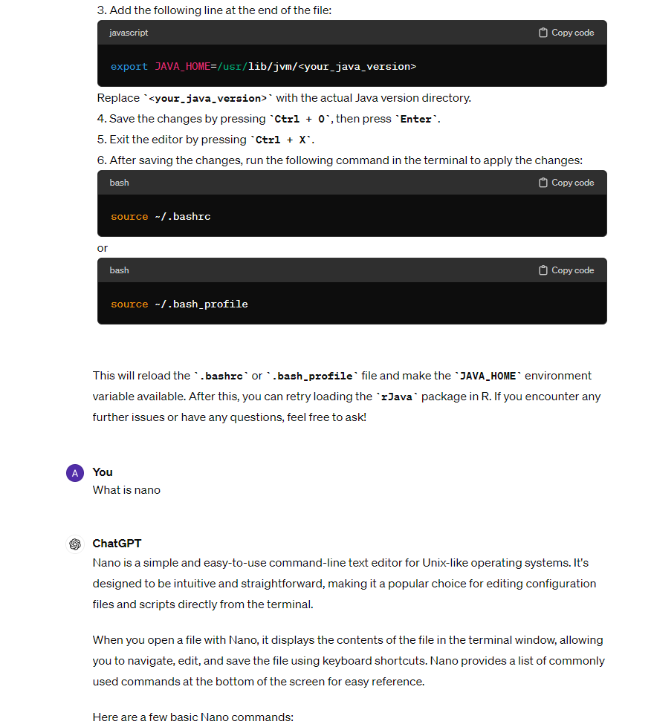
Background Objectives Prompts and debugging Success Discussion and conclusion

Slide 13
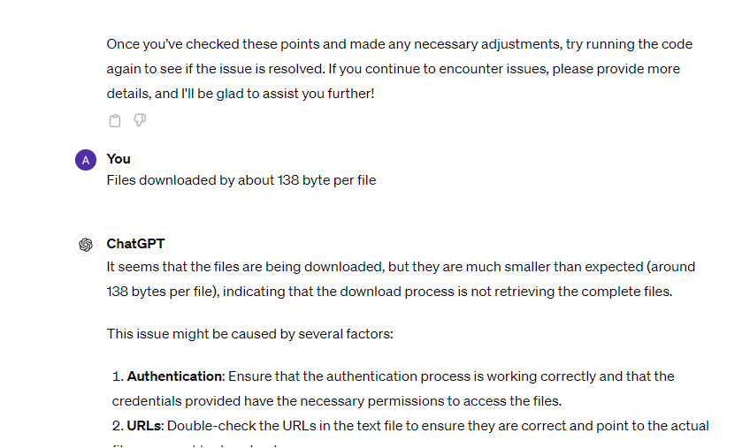
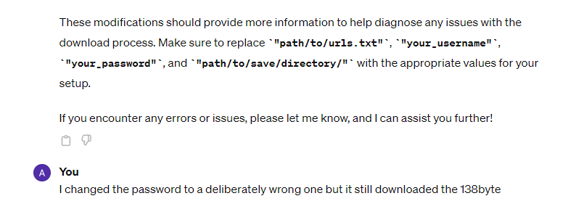
Starting all over
Background Objectives Prompts and debugging Success Discussion and conclusion

Slide 14
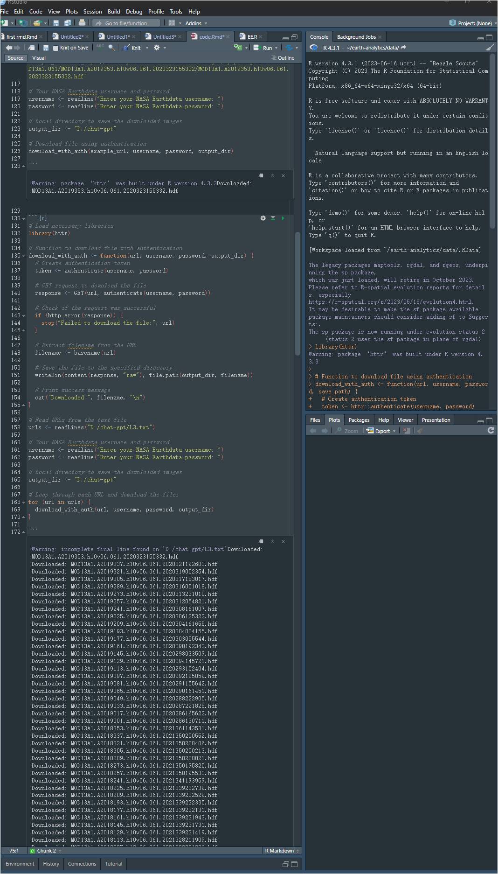
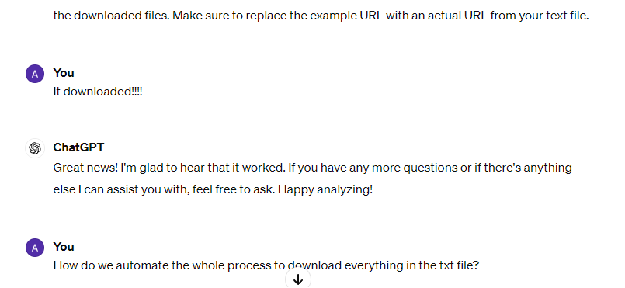
Success!
Background Objectives Prompts and debugging Success Discussion and conclusion

Slide 15
Discussion and conclusion
The need for details, yet specific
Chat-GPT3.5 is not optimized for context- Chat-GPT is not human
Chat-GPT can drift off
Chat-GPT3.5 likely uses the most popular word or phrase in its understanding
Machine-machine communication
Documentation
Ready-to-run codes (mostly 1/2 errors)
All programing needs in a single interface.
Catches simple errors
Options and different approaches to the same task.
Background Objectives Prompts and debugging Success Discussion and conclusion

Slide 16
References
Merow C, Serra-Diaz, JM, Enquist, BJ, & Wilson AM. 2023. AI chatbots can boost scientific coding. Nature Ecology & Evolution. https://doi.org/10.1038/s41559-023-02063-3
Perkel JM. 2023. Six tips for better coding with ChatGPT. Nature. https://doi.org/10.1038/d41586-023-01833-0

